Slide 1
Polymorphism

Slide 2
Objectives
Overloading and Overriding
Interface
Abstract class

Slide 3
Polymorphism
Ability allows many versions of a method based on overloading and overriding methods techniques.
Overloading: A class can have some methods which have the same name but their parameter types are different.
Overriding: A method in the father class can be overridden in its derived classes (body of a method can be replaced in derived classes).

Slide 4
Overloading
overloading with constructors public Rectangle(){…}
public Rectangle(int length, int width){… }
Overloading also extends to general methods. public void setValue(int len){ length= (len>0)?1:0; } public void setValue (int len, int wi){ length= (len>0)? 1: 0; width= (wi>0)? wi:0; }
Rectangle
# length: int # width: int
+ Rectangle(); + Rectangle(int, int) + setValue(int): void + setValue(int, int): void

Slide 5
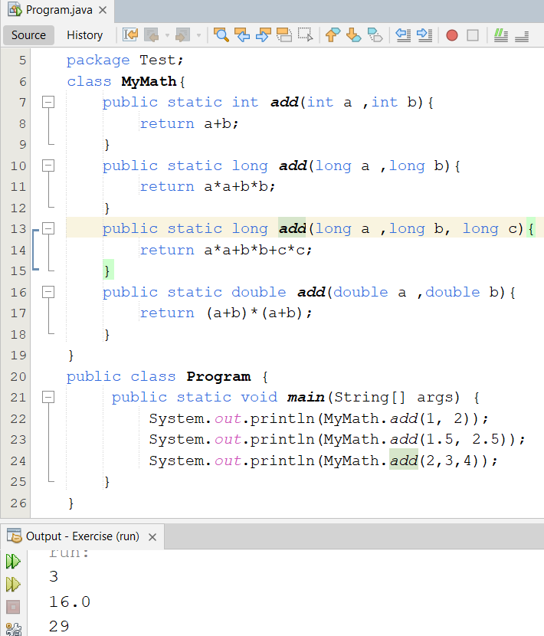
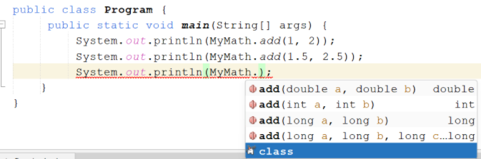
Overloading

Slide 6
Overriding
Rectangle
# length: int # width: int
+ Rectangle(); + Rectangle(int, int) + setValue(int ):void + setValue(int ,int ):void + toString(): String
Box
Height: int
+ Box(); + Box(int, int, int) + toString(): String + set(int, int, int ): void

Slide 7
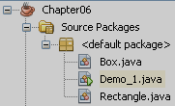
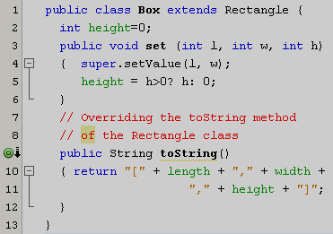
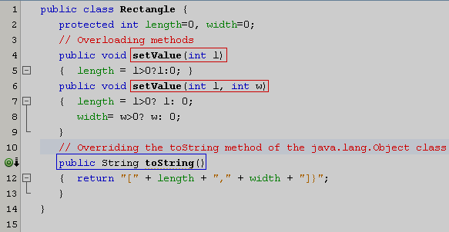

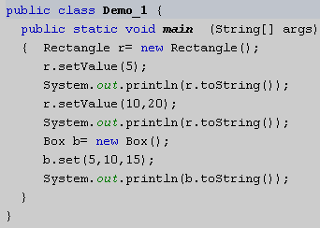
Overriding Inherited Methods
Overridden method: An inherited method is re-written
Overloaded methods: Methods have the same name but their parameters are different in a class

Slide 8
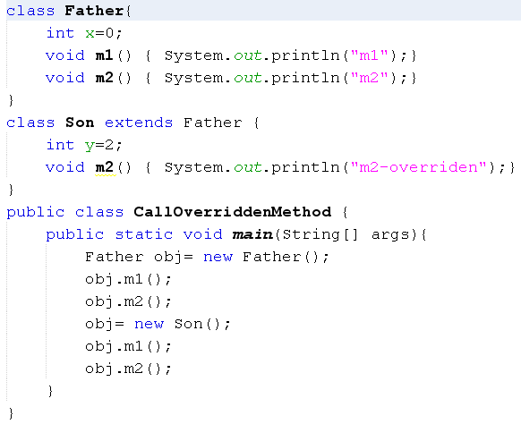
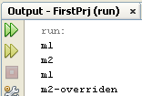
How Can Overridden Method be Determined?

Slide 9
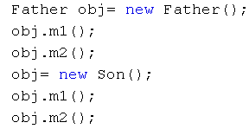
How Can Overridden Methods be Determined?
Son(declaration)
int y=2
Method Table
(m1, 600)
(m2, 800)
800
m2()
700
Father(declaration)
int x=0
Method Table
(m1, 600)
(m2, 650)
Class: 700
Class: 500
y=2
8000
x=0
9000
x=0
650
m2()
600
m1()
obj: 8000
obj: 9000
500
obj.m1();
obj.m2();
obj.m1();
obj.m2();
Classes are loaded to static heap

Slide 10
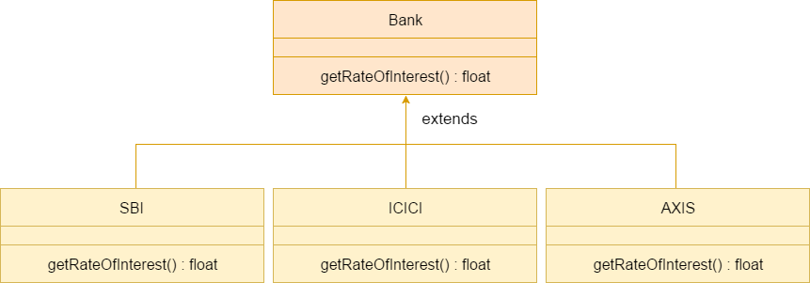
Example
Consider a scenario where Bank is a class that provides a method to get the rate of interest. However, the rate of interest may differ according to banks. For example, SBI, ICICI, and AXIS banks are providing 8.4%, 7.3%, and 9.7% rate of interest.

Slide 11
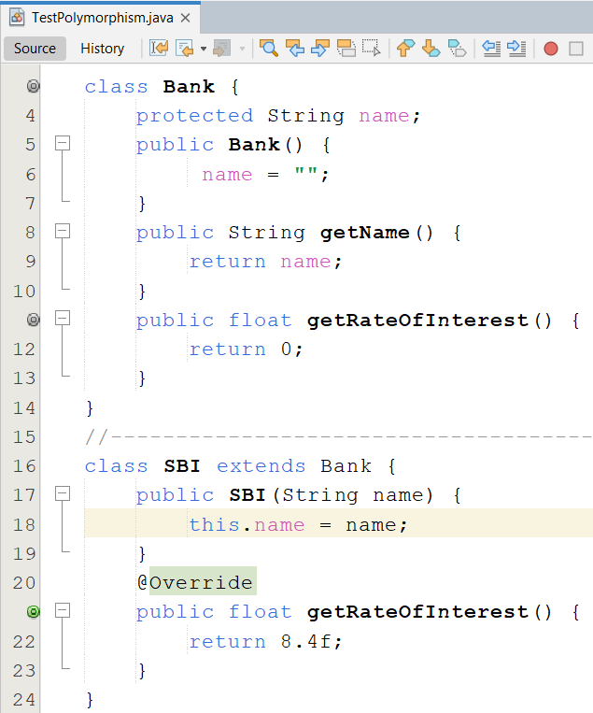
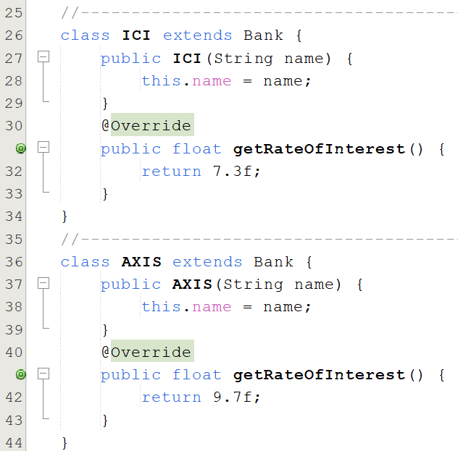
Implement

Slide 12
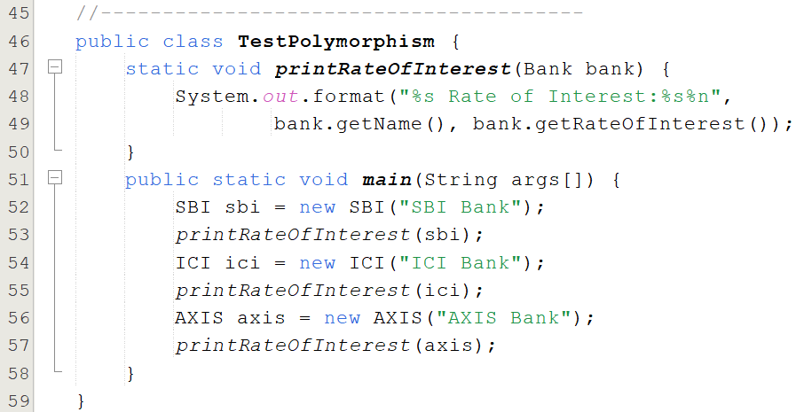
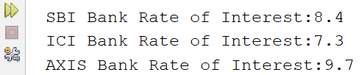
Implement

Slide 13
Interfaces
An interface is a reference type, similar to a class, that can contain only constants, initialized fields, prototypes (abstract methods, default methods), static methods, and nested types.
It will be the core of some classes
Interfaces cannot be instantiated because they have no-body methods.
Interfaces can only be implemented by classes or extended by other interfaces.

Slide 14
WHY AND WHEN TO USE INTERFACES?
To achieve security - hide certain details and only show the important details of an object (interface).
Java does not support "multiple inheritance" (a class can only inherit from one superclass). However, it can be achieved with interfaces, because the class can implement multiple interfaces

Slide 15
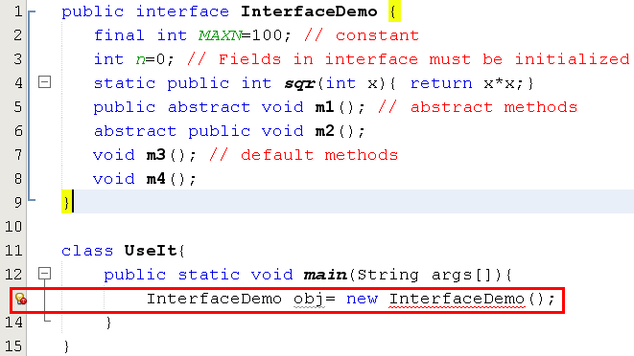

Interfaces…

Slide 16
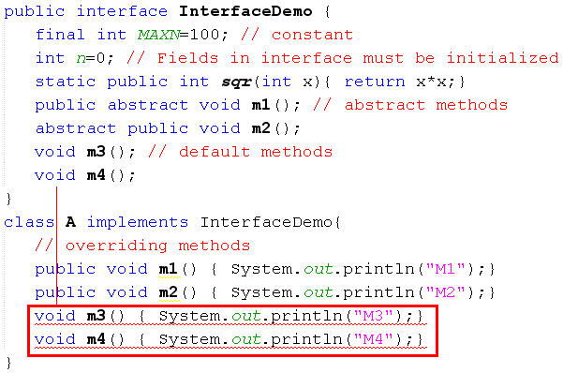
Interfaces…
m3(), m4() in A cannot implement m3(), m4() in InterfaceDemo, attempting to assign weaker access privileges, were public
Default methods of an interface must be overridden as public methods in concrete classes.

Slide 17
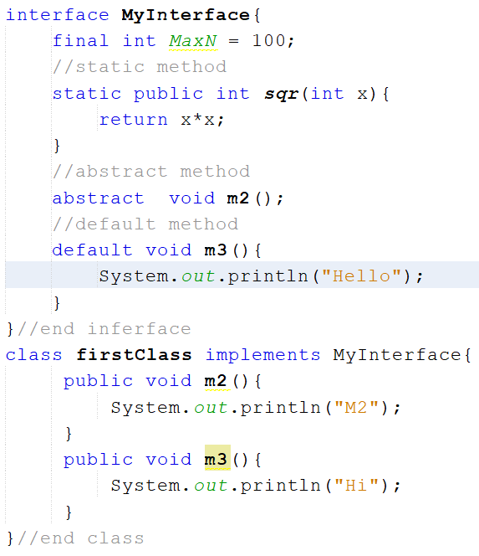
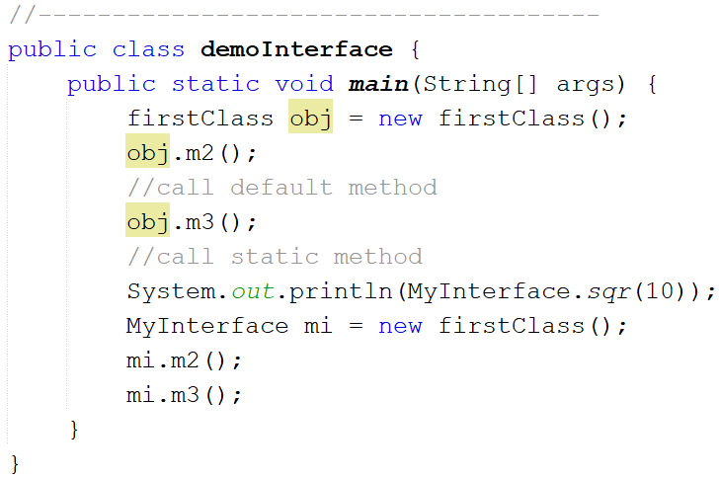
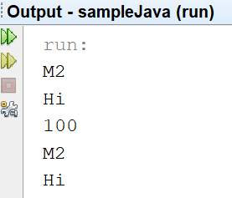

Slide 18
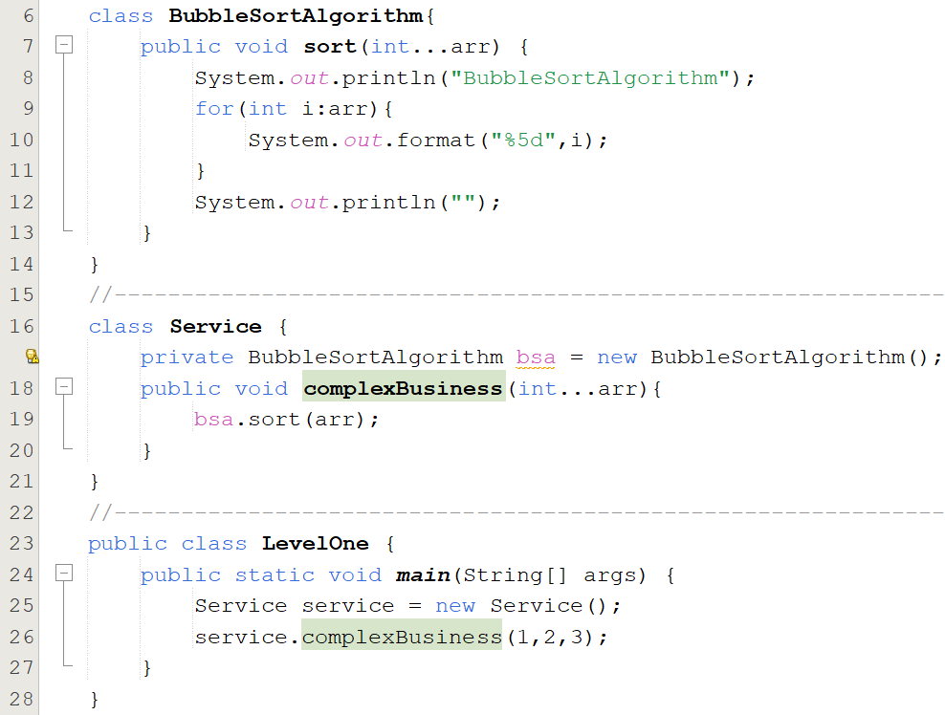

Case Study - Interface
Solution 01

Slide 19
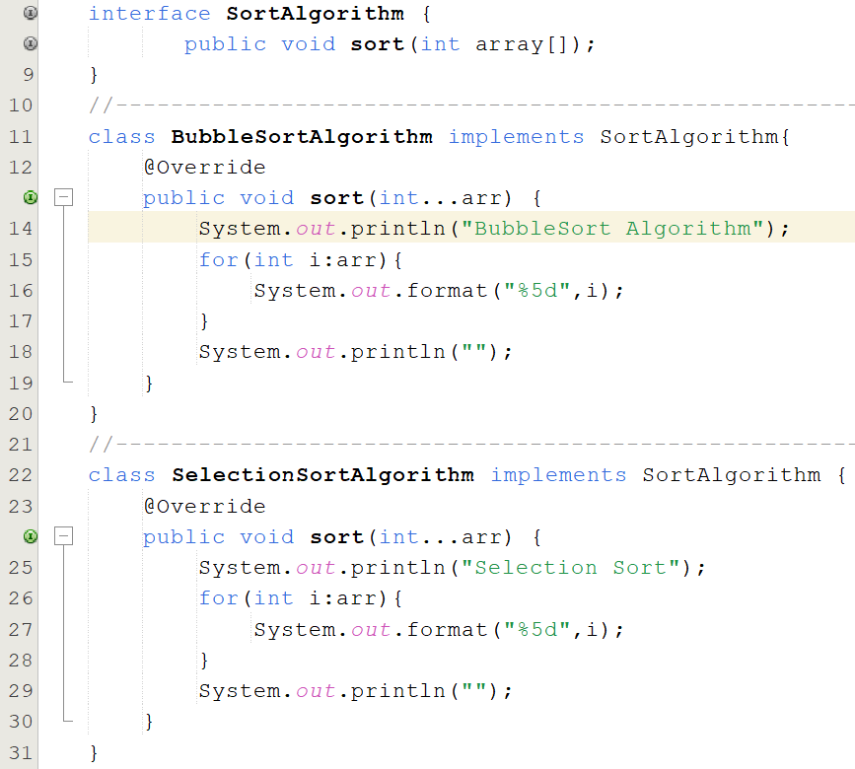
Case Study - Interface
Solution 02

Slide 20
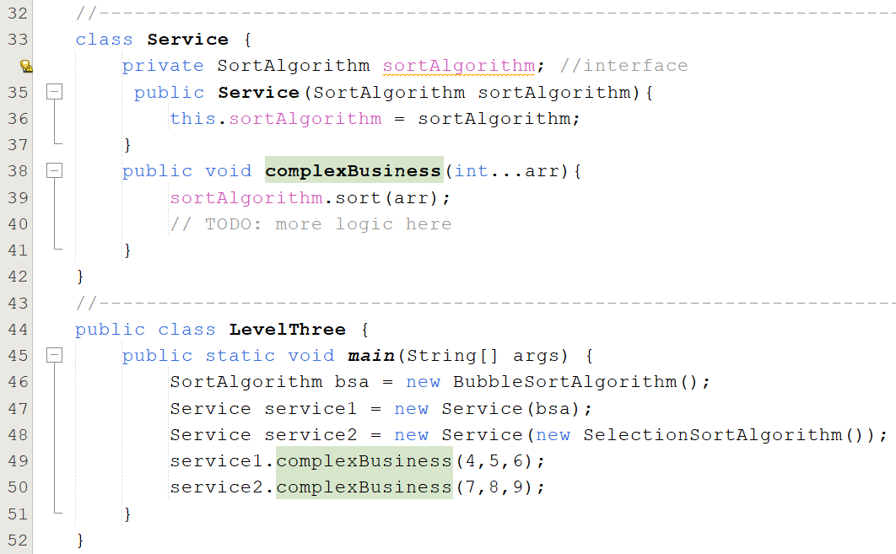
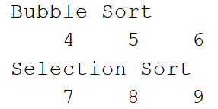
Case Study - Interface

Slide 21
Abstract Classes
Used to define what behaviors a class is required to perform without having to provide an explicit implementation.
It is the result of so-high generalization
Syntax to define a abstract class
public abstract class className{ ... }
It isn’t necessary for all of the methods in an abstract class to be abstract.
An abstract class can also declare implemented methods.

Slide 22
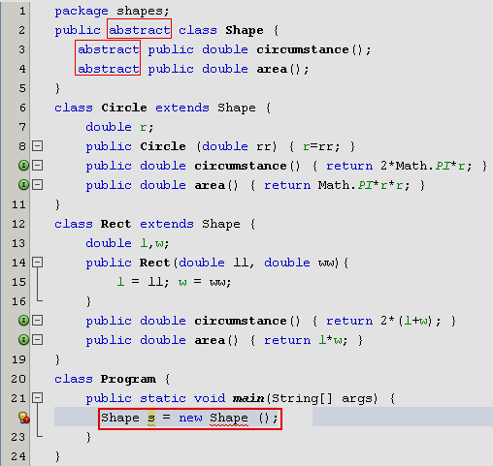
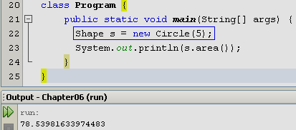
Abstract Classes…
Modified
Notes:
Shape s = new Circle(5);
System.out.println(s.area());
s = new Rect(10,5);
System.out.println(s.area());
---------------------------

Slide 23
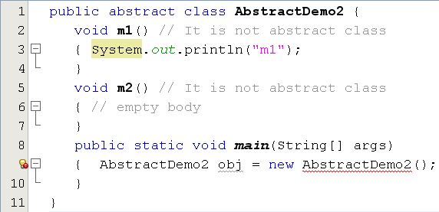
Abstract Classes…
This class have no abstract method but it is declared as an abstract class. So, we can not initiate an object of this class.

Slide 24
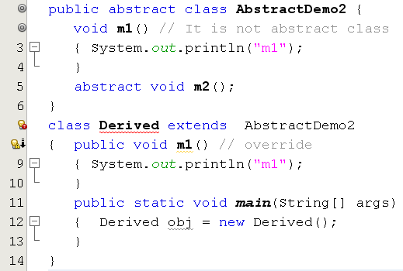
Abstract Classes…
Error. Why?

Slide 25
Implementing Abstract Methods
Derive a class from an abstract superclass, the subclass will inherit all of the superclass’s features, all of abstract methods included.
To replace an inherited abstract method with a concrete version, the subclass need merely override it.
Abstract classes cannot be instantiated

Slide 26
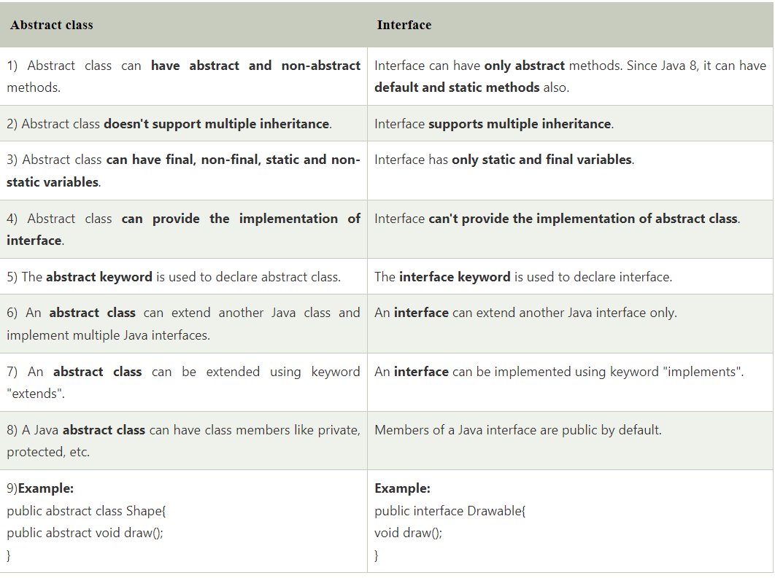
Difference between Abstract class and Interface

Slide 27
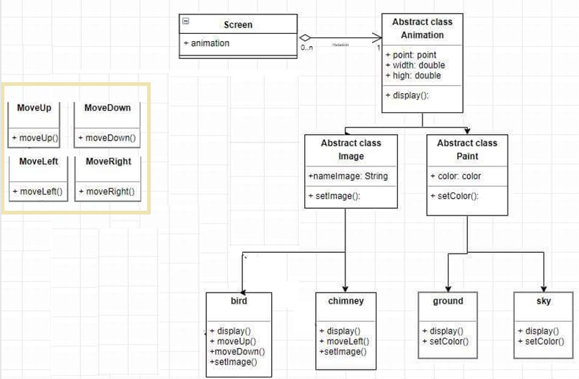
Example

Slide 28
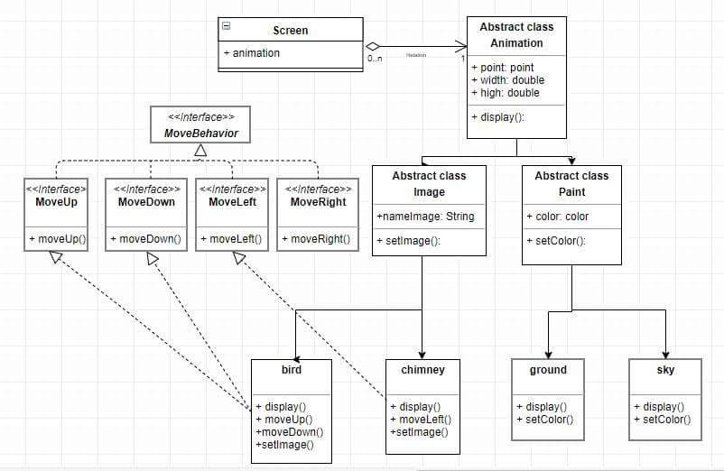
Example

Slide 29
Anonymous Classes
Anonymous classes are classes which are not named but they are identified automatically by Java compiler.
Where are they? They are identified at initializations of interface/abstract class object but abstract methods are implemented as attachments.
Why are they used?
Enable you to make your code more concise.
Enable you to declare and instantiate a class at the same time.
They are like local classes except that they do not have a name.
Use them if you need to use a local class only once.

Slide 30
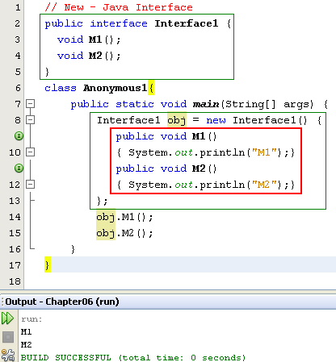

Anonymous Class…
Anonymous class.
Class name is given by the compiler:
ContainerClass$Number

Slide 31
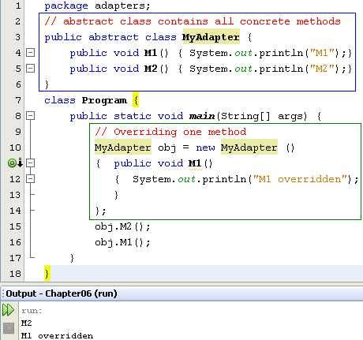
Anonymous Class…
Concrete methods but they can not be used because the class is declared as abstract one.
The abstract class can be used only when at least one of it’s methods is overridden
Anonymous class is a technique is commonly used to support programmer when only some methods are overridden only especially in event programming.

Slide 32
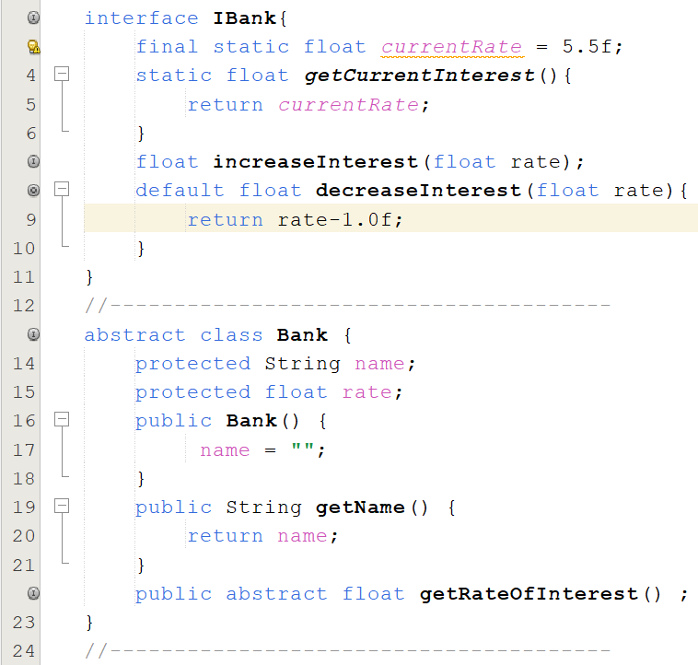
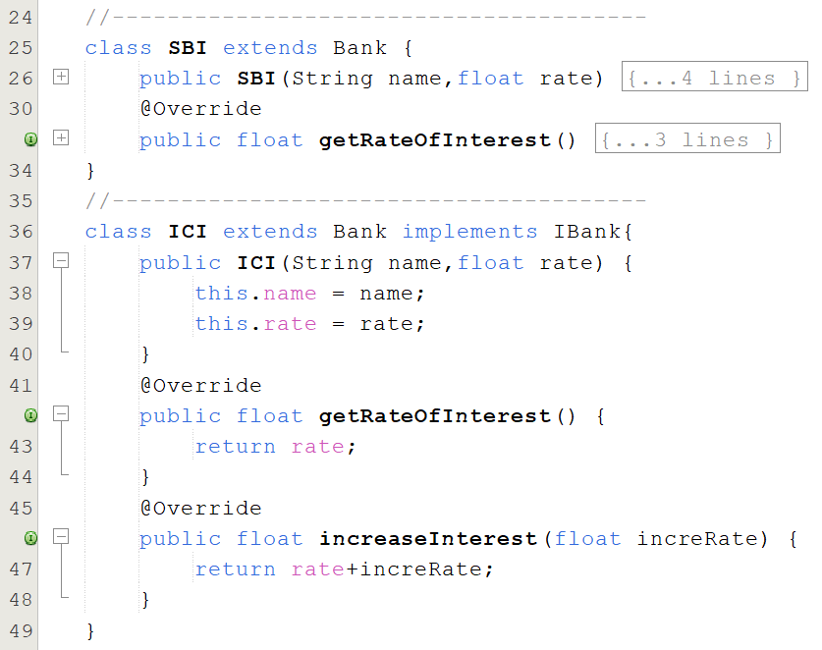
Case Study Interface & Abstract Class

Slide 33
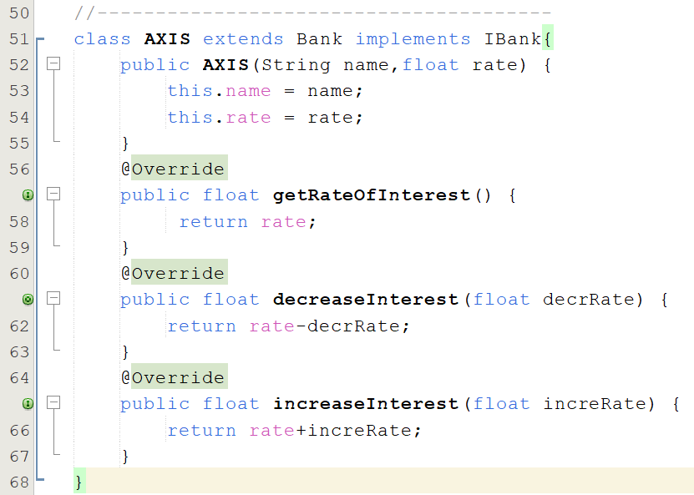
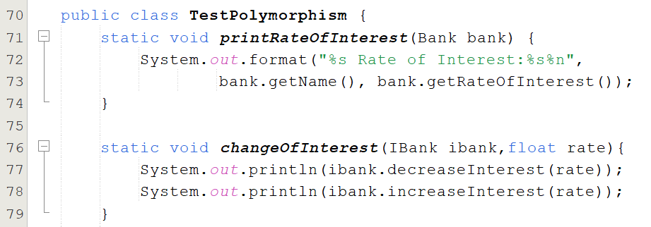
Case Study Interface & Abstract Class

Slide 34
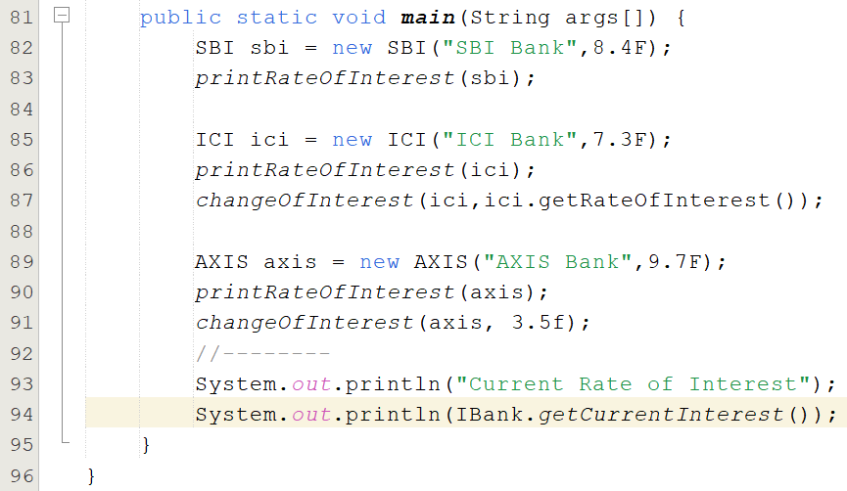
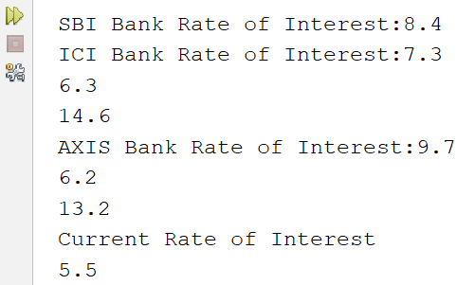
Case Study Interface & Abstract Class

Slide 35
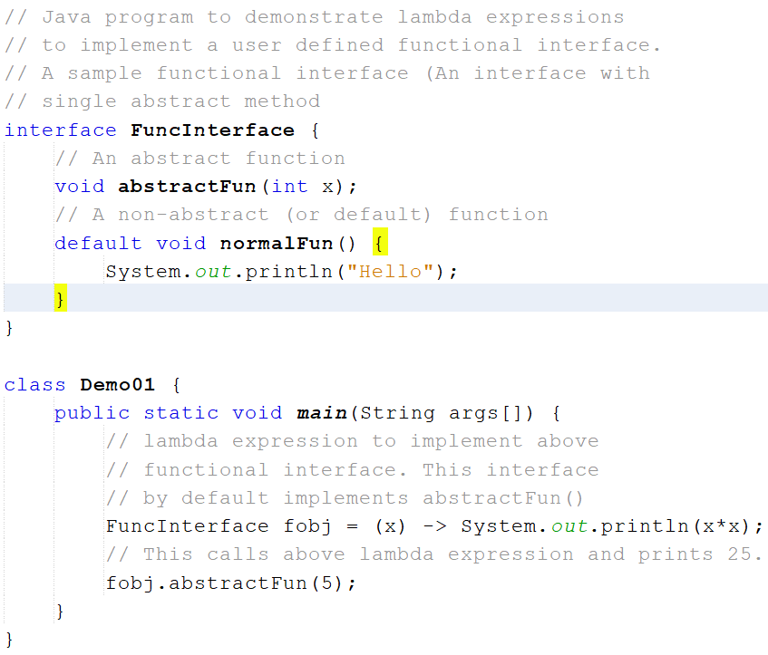
More Lambda Expression (…)

Slide 36
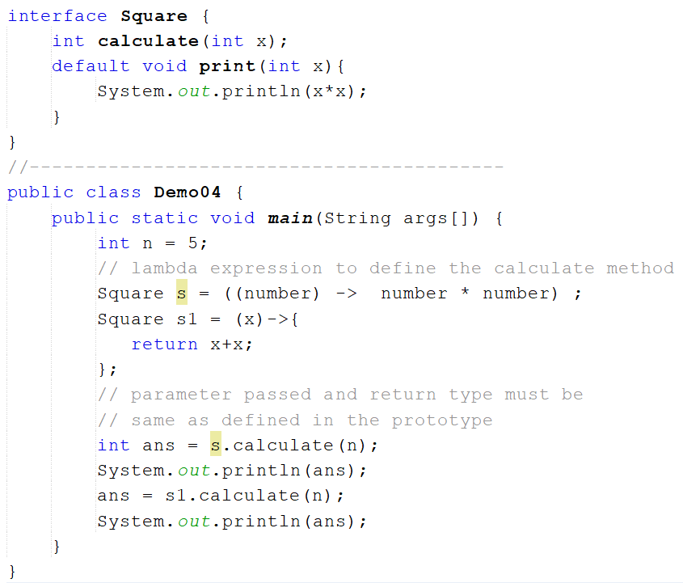
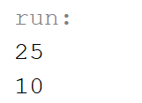
More Lambda Expression (…)

Slide 37
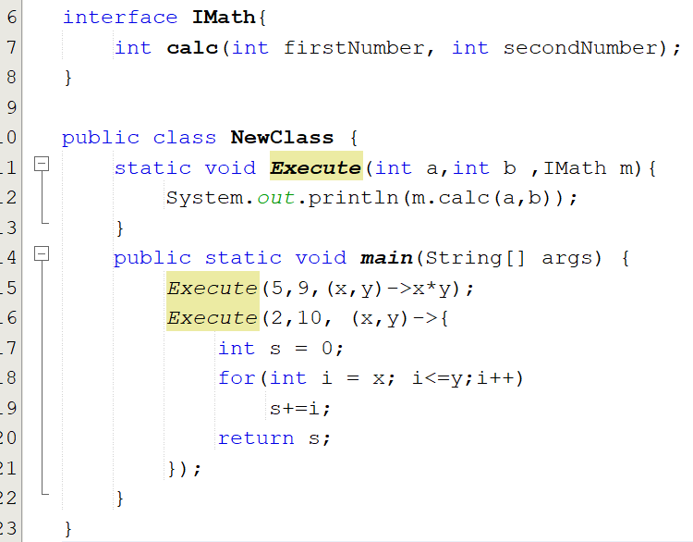

More Lambda Expression (…)

Slide 38
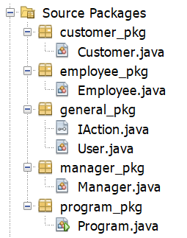
Practice : Abstract Class & Interface
Create a project as the follows :

Slide 39
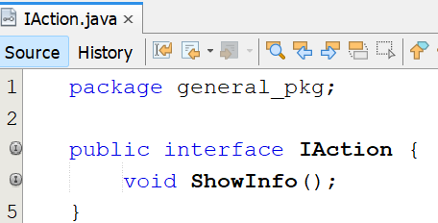

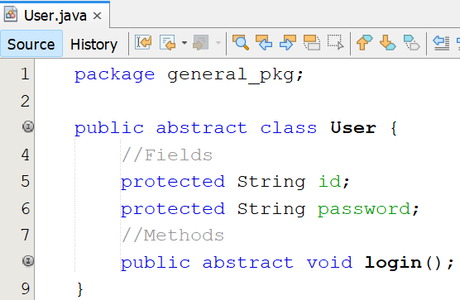
Practice : Abstract Class & Interface
Write codes for classes and interfaces :

Slide 40

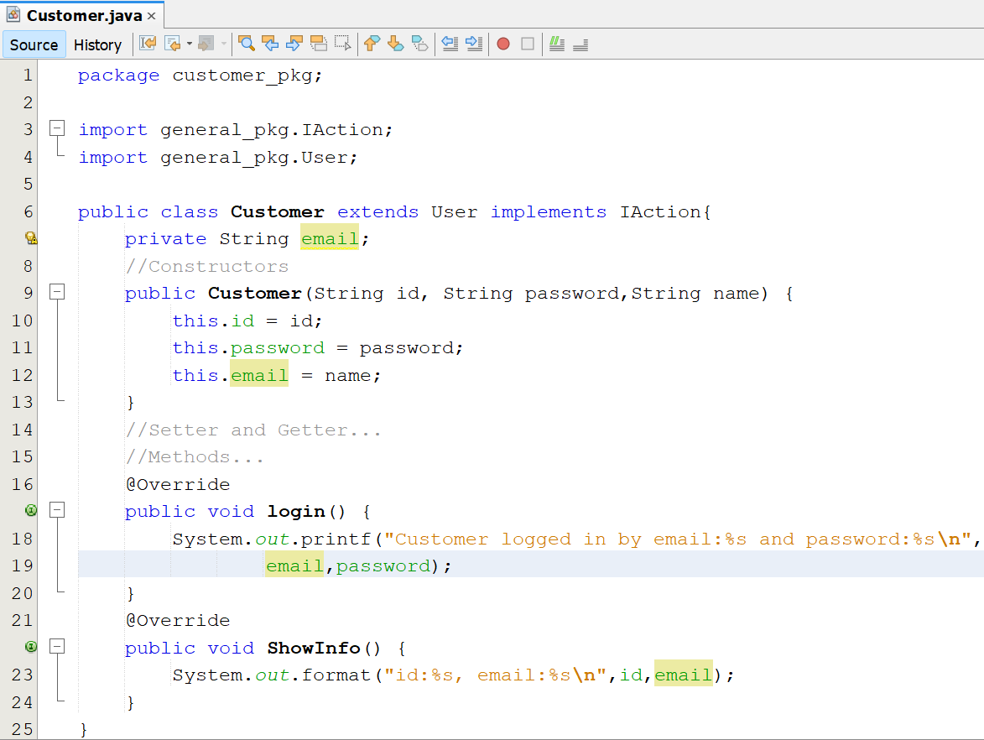
Practice : Abstract Class & Interface

Slide 41

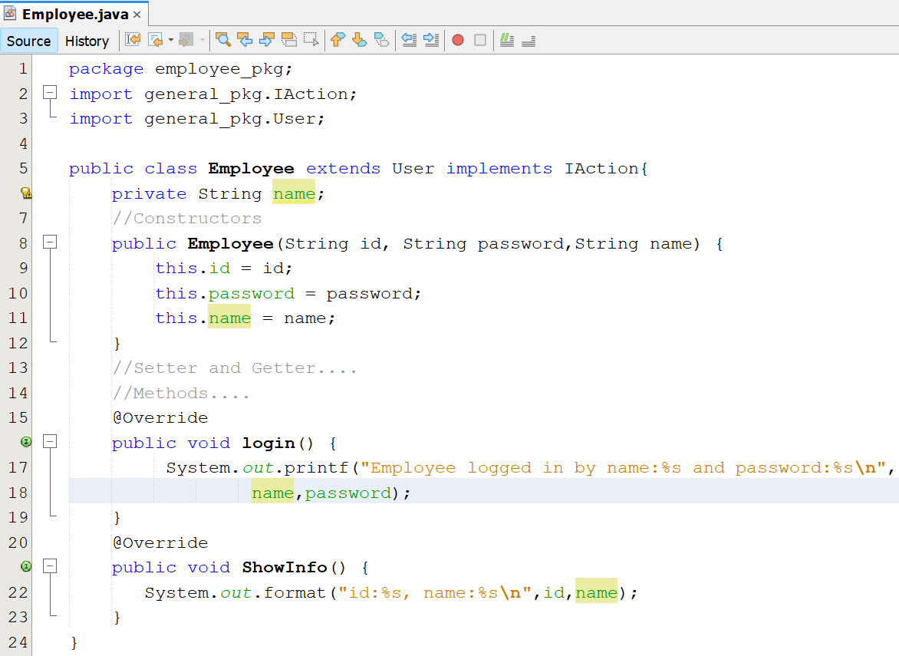
Using Abstract Class & Interface

Slide 42

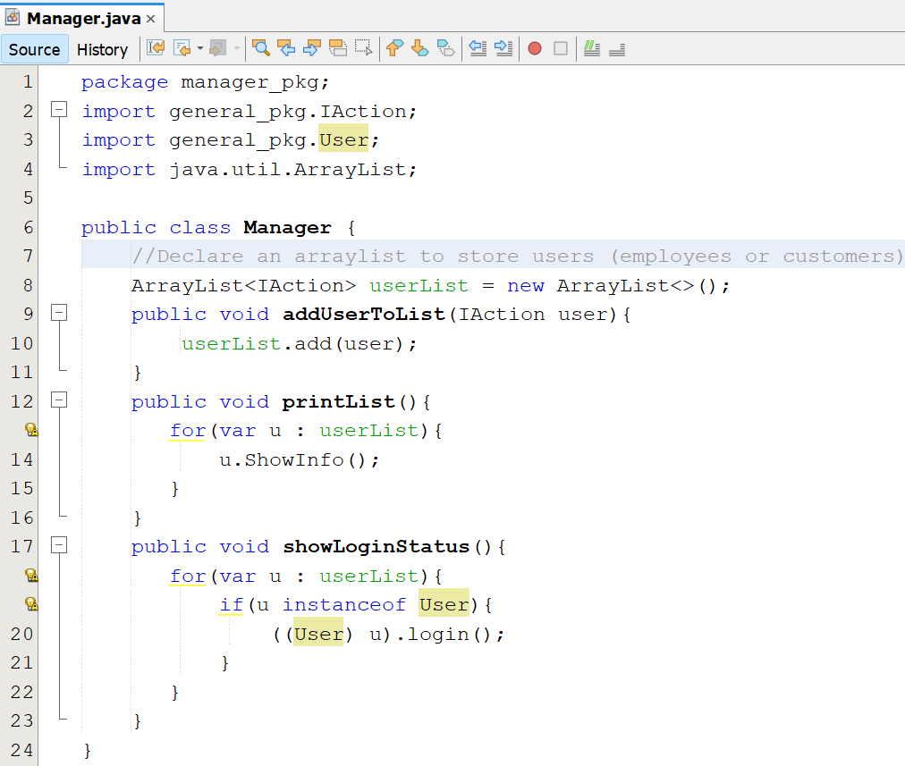
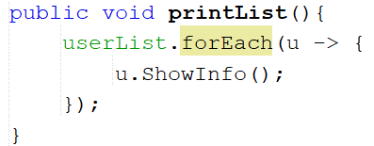
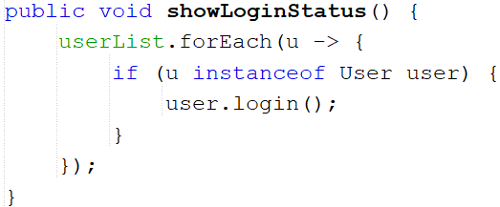
Practice : Abstract Class & Interface

Slide 43



Practice : Abstract Class & Interface

Slide 44


Review

Slide 45
Summary
Polymorphism is a concept of object-oriented programming
Polymorphism is the ability of an object to take on many forms
Overloading and overriding are a technology to implement polymorphism feature.
In OOP occurs when a parent class/ interface reference is used to refer to a child class object

